Slide 1

Credit Card Fraud Detection with Machine Learning Techniques
Presented By
Farhat Lamia Barsha
Tennessee Technological University
1

Slide 2
Outline
Introduction
Paper Overview
Dataset
Methodology
Experimental Setup
Result
Discussion
2

Slide 3
Introduction
Credit card fraud is an expression of identity theft that happens when an individual obtains someone’s private information without authorization and uses it for financial transactions.
The United States experienced a 13% rise in credit card fraud cases from 2021 to 2022.
There are two types of credit card fraud: (1) Card present fraud and (2) Card-not-present fraud.
Machine learning classification algorithms offers the potential to detect and prevent fraudulent transactions more efficiently than traditional methods.
Various challenges in credit card fraud detection still exist, including imbalanced datasets, overlapping data, misclassification, constrained datasets, changing fraud patterns over time, feature generation, fraud detection cost, lack of standard metrics, etc.
3

Slide 4
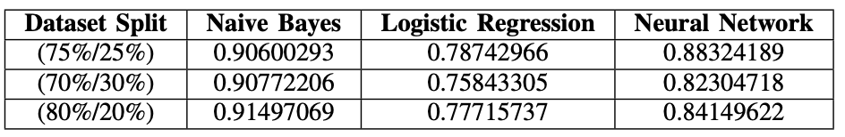
Paper Overview
The study focuses on the identification of credit card fraud transactions using publicly accessible datasets from Kaggle.
The researchers employ three different machine learning algorithms, including Naive Bayes, logistic regression, and artificial neural networks.
The experimental findings indicate that logistic regression outperformed Naive Bayes and neural network techniques in terms of accuracy in balanced data distribution.
In imbalanced data distribution, the Naive Bayes algorithm exhibited superior performance compared to logistic regression and neural networks.
Accuracy Comparison:
4

Slide 5
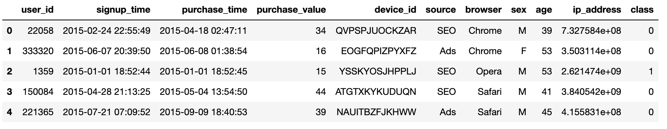
Dataset
Dataset source: Kaggle website
Total number of data: 151112
Real Transactions: 136961
Fraud Transactions: 14151
Not Fraud: 90.64%
Fraud: 9.36%
5

Slide 6
Methodology
Machine Learning Techniques:
Logistic Regression
Naïve Bayes
Deep Learning Techniques:
Artificial Neural Network (ANN)
Convolutional Neural Network (CNN)
Generative Adversarial Networks (GANs)
6

Slide 7
Experimental Setup
Dataset loading
Feature
Engineering
Data Preprocessing
Under sampling
Model Evaluation
Making Predictions
Training the Model
Model Construction
Fig: Experimental Setup
7

Slide 8
Results
Table: Basic metric rates comparison with Logistic Regression, Naive Bayes, ANN, CNN and GANs
Metrics | Logistic Regression | Naïve Bayes | ANN | CNN | GANs
True Positive Rate | 2363 | 2287 | 1546 | 2307 | 1901
False Positive Rate | 1807 | 1587 | 51 | 1583 | 754
True Negative Rate | 994 | 1214 | 2750 | 1218 | 2047
False Negative Rate | 497 | 573 | 1314 | 553 | 959
8

Slide 9
Results
Table: Comparison with Logistic Regression, Naive Bayes, ANN, CNN and GANs
 | Logistic Regression | Naïve Bayes | ANN | CNN | GANs
Accuracy | 0.5930047694753577 | 0.6184419713831478 | 0.758876523582406 | 0.6226815050344462 | 0.6974032856385798
Precision | 0.5666666666666667 | 0.5903458957150233 | 0.9680651221039449 | 0.5930591259640103 | 0.7160075329566855
Recall | 0.8262237762237762 | 0.7996503496503496 | 0.5405594405594406 | 0.8066433566433566 | 0.6646853146853147
F1-score | 0.6722617354196301 | 0.6792396792396793 | 0.6937401839802558 | 0.6835555555555556 | 0.6893925657298277
9

Slide 10
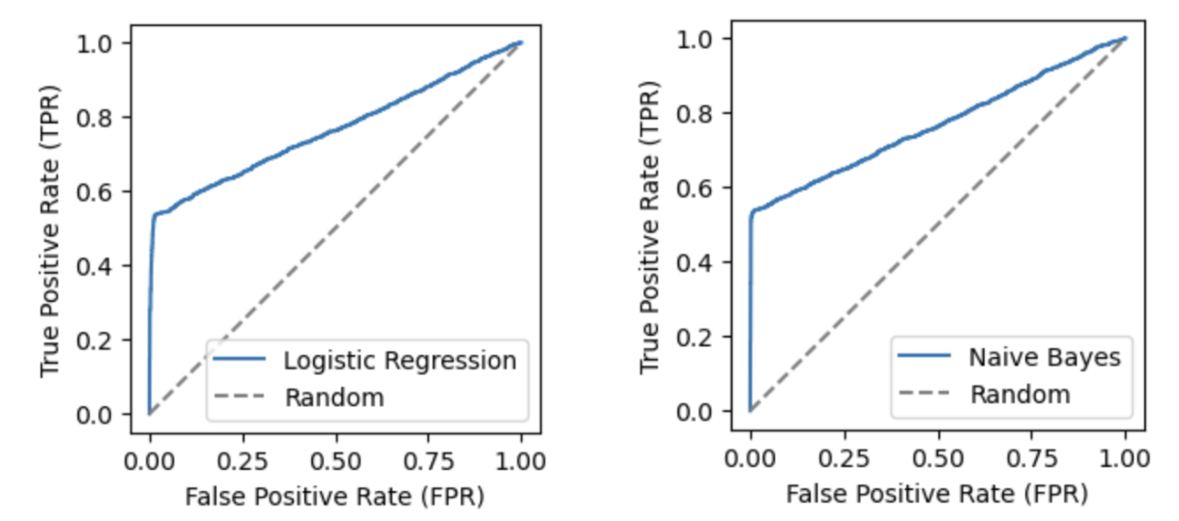
Results
10

Slide 11
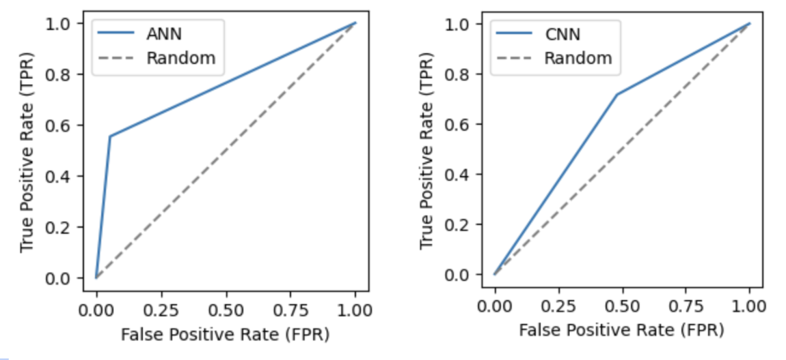
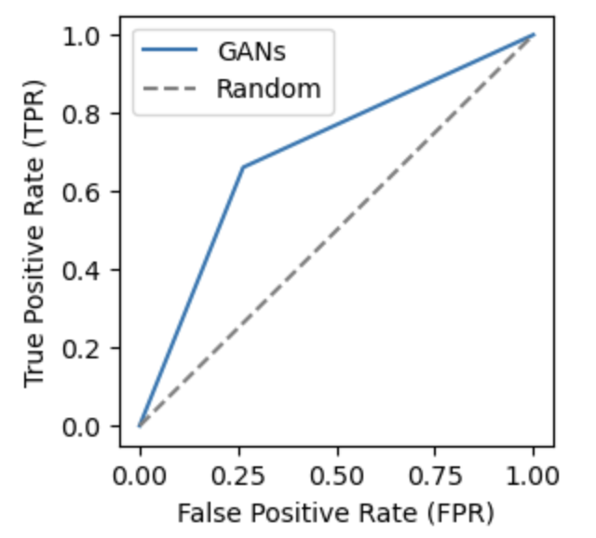
Results
11

Slide 12
Discussion
Deep learning algorithms perform better than traditional Machine learning algorithms.
The CNN and GAN both provide a good balance between precision and recall.
The Generative Adversarial Networks (GANs) demonstrates considerable potential as a viable option among other models with high precision and decent recall.
The research paper didn’t consider the class imbalance issue while I have under sampled my dataset to train the model.
The research paper primarily concentrated on accuracy as the sole metric for evaluating model performance, while I underlined the significance of incorporating precision and recall as additional evaluation metrics.
12

Slide 13
Thank You

